Slide 1

RUNGTA COLLEGE OF DENTAL SCIENCES AND RESEARCH
Dept of Prosthodontics
3rd Year BDS
Minor Connector
Presented By:
Dr.Shilpi Karpathak
Professor
Dept of Prosthodontics

Slide 2
Specific Learning Objective
Core areas | Domain | Category
Introduction Definitions | Cognitive | Must Know
Minor connector that joins clasp assemblies to major connector Minor connector that joins indirect retainers or auxiliary rests to major connector | Cognitive | Must Know
Minor connector that joins denture bases to major connectors Minor connector that serve as approach arms for vertical projection/bar-type clasp | Psychomotor | Must Know
Summary | Affective | Must Know

Slide 3
Contents
Introduction
Definitions
Minor connector that joins clasp assemblies to major connector
Minor connector that joins indirect retainers or auxiliary rests to major connector
Minor connector that joins denture bases to major connectors
Minor connector that serve as approach arms for vertical projection/bar-type clasp
Summary
References

Slide 4
introduction
Primary function of a minor connector is to join the remaining components of a removable partial denture to the major connector
It also is responsible for distribution of applied forces to the supporting teeth and oral tissues.
Rigidity is essential criteria for minor connector

Slide 5
definitions
The connecting link between the major connector or base of a partial removable dental prosthesis and the other units of the prosthesis , such as the clasp assembly , indirect retainers , occlusal rests, or cingulum rests.
Functions-
1.joins major connector with other component parts.
2.transfers and distributes functional stress to the abutment teeth and residual ridge
3.transfers effect of retainers , rests and stabilizing components to the reminder of the denture.

Slide 6
Types - 4
1 minor connector that joins clasp assemblies to major connector
2 minor connector that joins indirect retainers or auxiliary rests to major connector
3 minor connector that joins denture bases to major connectors
4 minor connector that serve as approach arms for vertical projection/bar-type clasp

Slide 7
1 minor connectors joining clasp assemblies to major connector
1.Rigid-as they support the active components of RPD, the retentive clasp
-Support the rest-which prevent vertical movement of a prosthesis toward the underlying tissues.
2.Must have sufficient bulk to ensure the rigidity.
3.location- most minor connector supporting the clasp assemblies are located on proximal surfaces of teeth adjacent to edentulous areas.
4. They should be broad buccolingually, but thin mesiodistally.

Slide 8
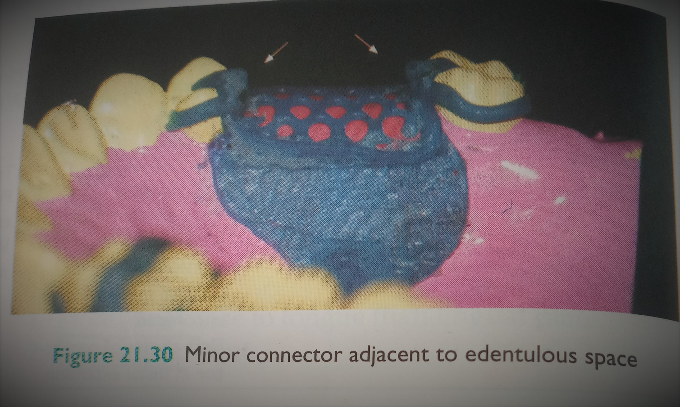

Slide 9
5. In many instances , a clasp assembly must be positioned on a tooth that is not adjacent to an edentulous space. When this occurs, a minor connector should be positioned in the associated lingual embrasure .this result in a sufficient bulk of metal without encroaching on the tongue space
6.minor connector should never be placed on the convex lingual surface of the tooth.

Slide 10
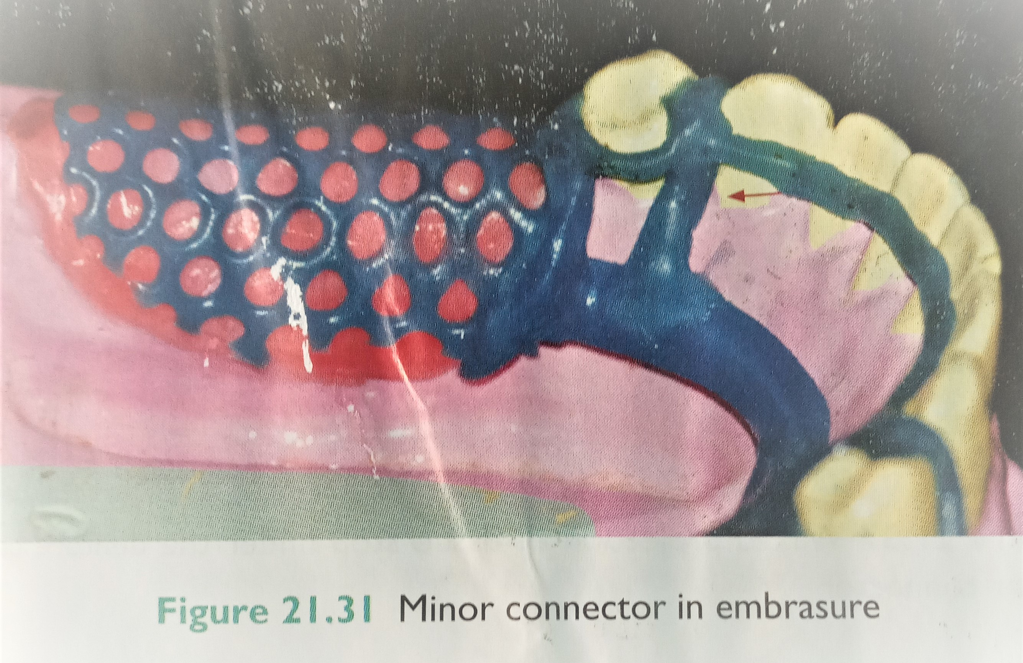

Slide 11
2.Minor connector joining the indirect retainers or auxiliary rests to major connectors
These minor connectors should form right angles with the corresponding major connectors , but junctions should be gently curved to prevent stress concentration.
Positioned on the lingual embrasures

Slide 12
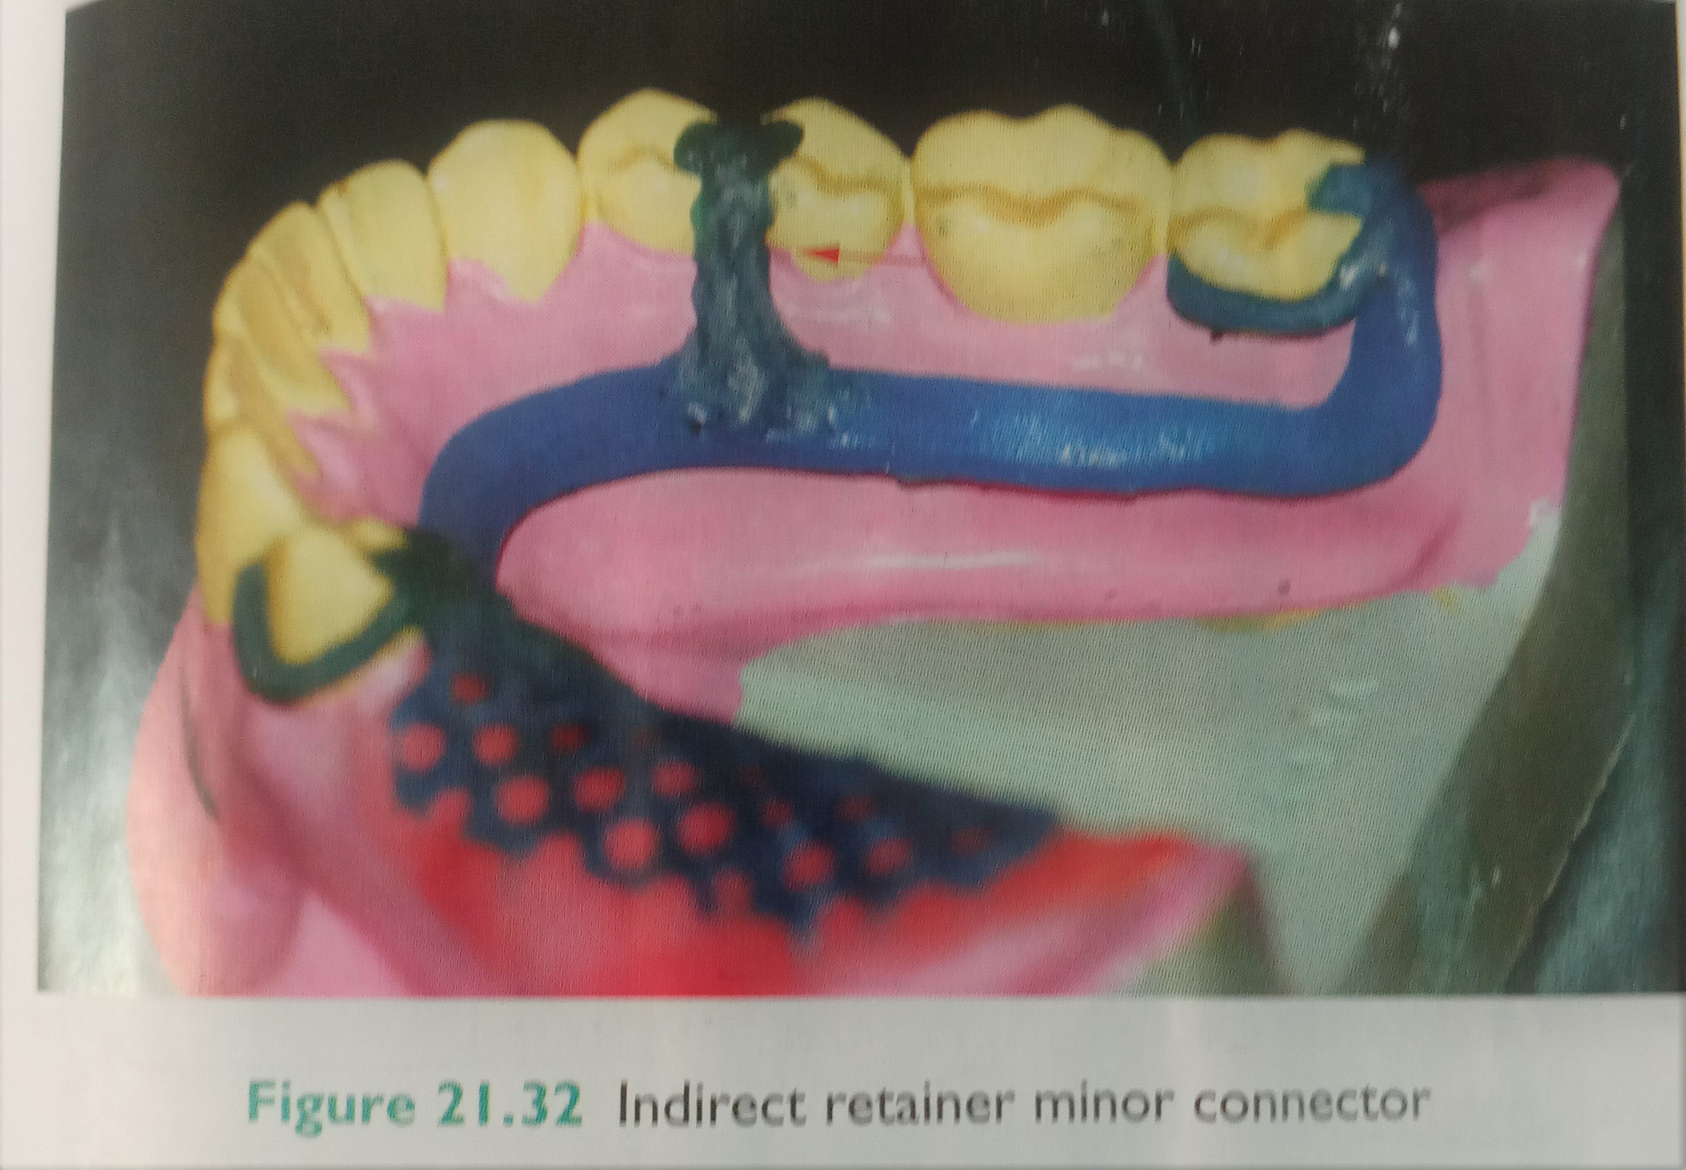

Slide 13
3. Minor connectors joining denture bases to major connector
Latticework construction
Mesh construction
Bead wire or nail head components on a metal base
Must be strong enough to anchor a denture base to the removable partial denture framework
Must be rigid enough to resist fracture and displacement.
Minimal interference with the arrangement of teeth

Slide 14
In maxillary arch, a distal extension base must extend entire length of the ridge and should cover the tuberosity. consequently the minor connector should be extended as far posteriorly as possible ( extend beyond the most prominent portion of the tuberosity/must be terminated anterior to this area).
In mandibular arch, a distal extension base must cover the retromolar pad . minor connector should extend two-third the length of the edentulous ridge. This provides adequate support and retention for the associated resin base

Slide 15
1. Latticework construction
Consists of longitudinal and transverse struts that form a ladder-like network
Placement of the longitudinal and transverse struts is a critical factor in prosthetic tooth arrangement
In mandibular arch, one longitudinal strut should be positioned buccal to the crest of the ridge and other lingual to the ridge crest.
In maxillary arch , one longitudinal strut should be positioned buccal to the ridge crest
The borders of the major connector generally will act as the second longitudinal strut

Slide 16
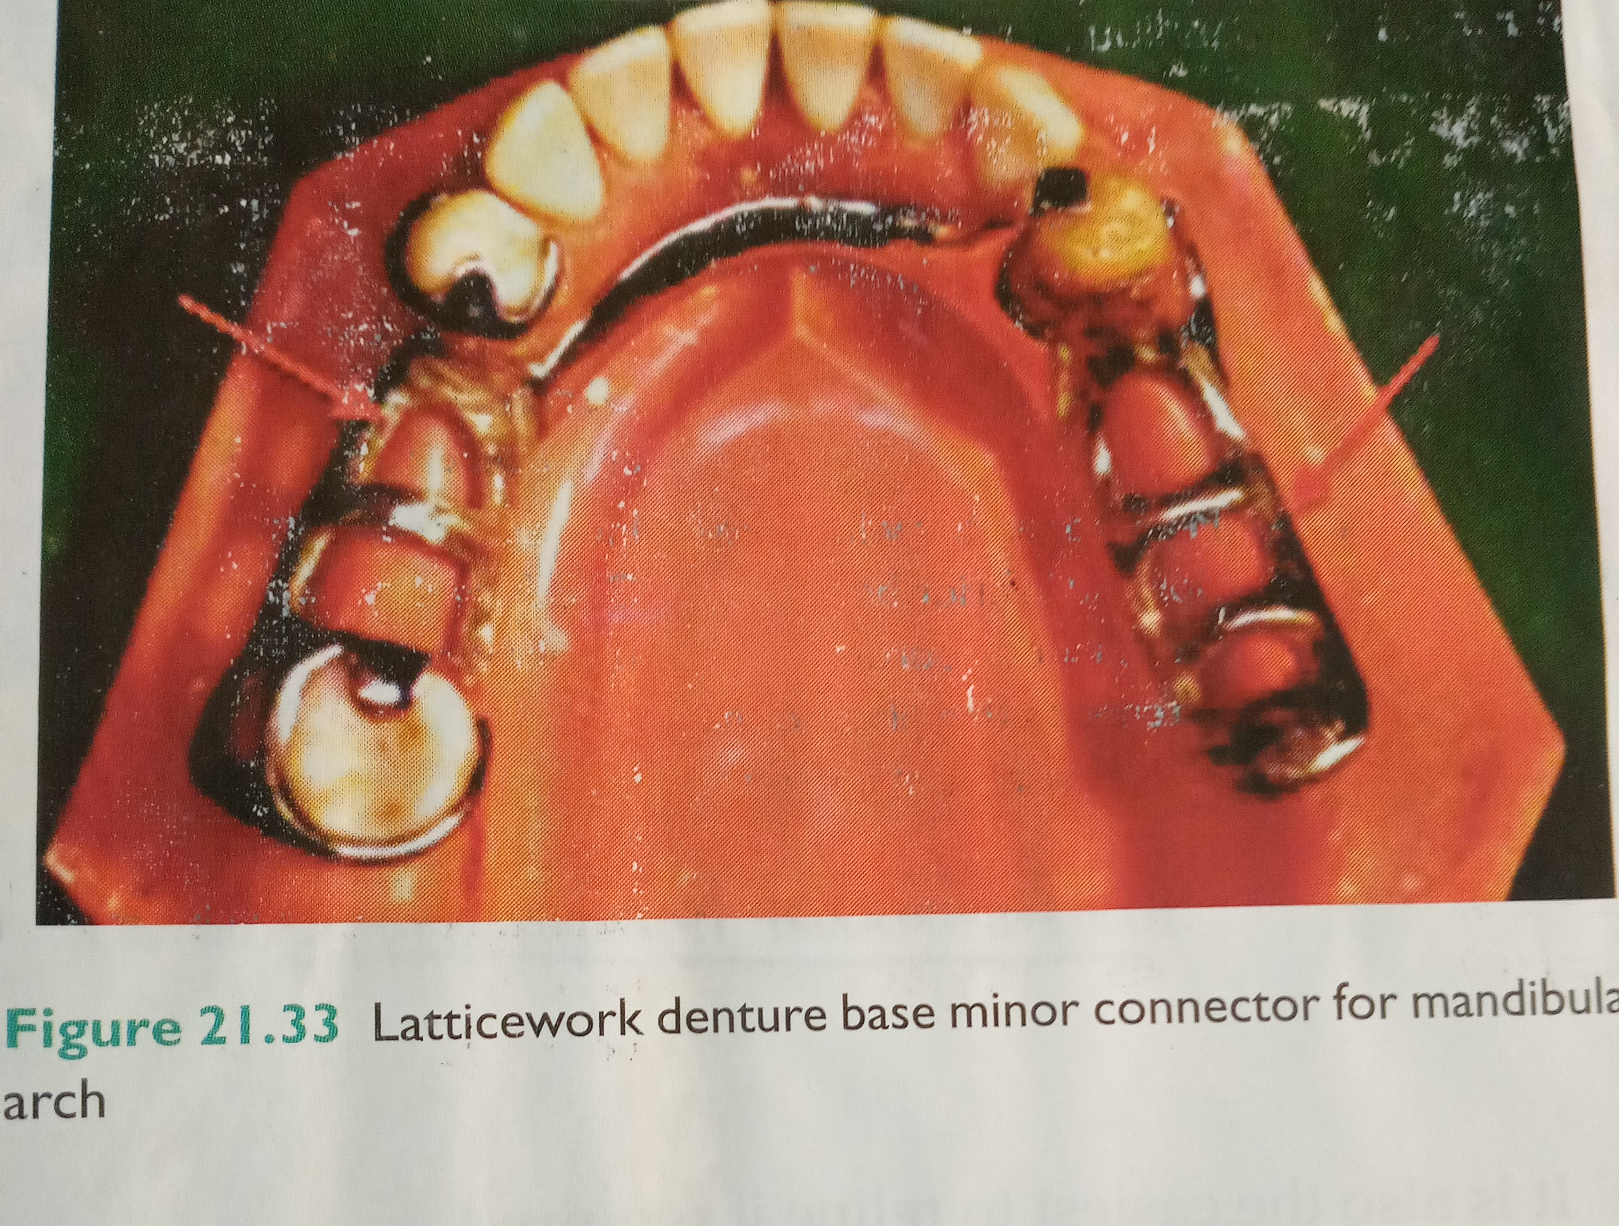

Slide 17
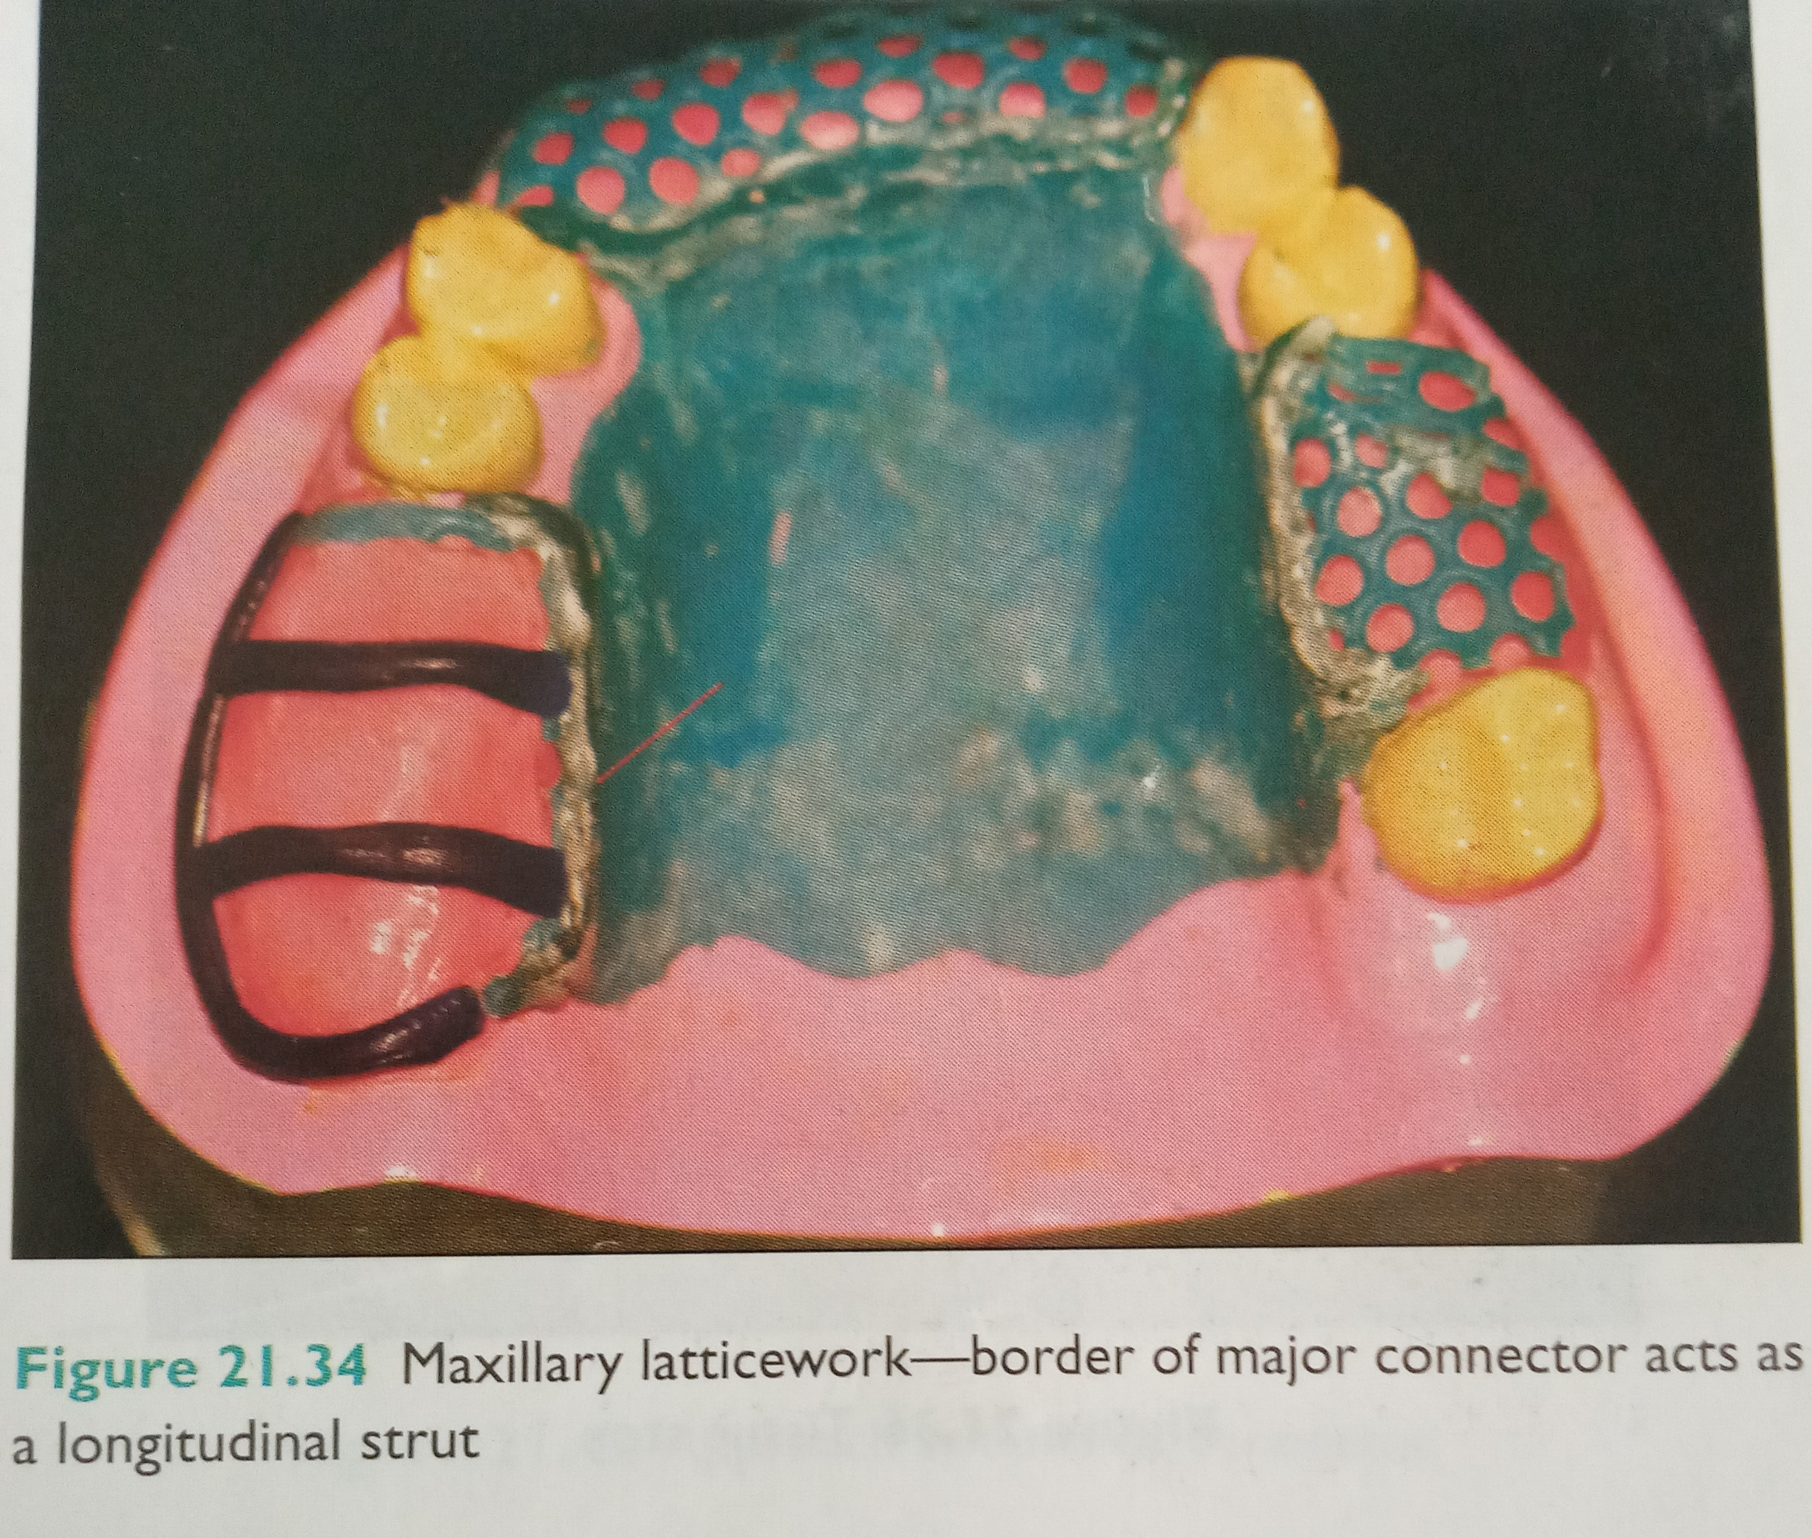

Slide 18
Positioning of a longitudinal strut along the crest of the ridge must be avoided. This not only interferes with the placement of artificial teeth , but also predisposes the denture base to fracture.
Transverse struts also must be positioned to facilitate the placement of artificial teeth. They should be designed to pass between the necks of the artificial teeth. This aids in tooth arrangement and often results in improved esthetics.
Open construction can be used whenever multiple teeth are to be replaced.
Studies have shown that this form of minor connector provides the strongest attachment of acrylic resin to the RPD framework.

Slide 19
During the framework fabrication process , those areas of a master cast that are to feature open retention must be relieved using an appropriate thickness of wax.
Relief provides space between the completed minor connector and tissues of the residual ridge.
This space permits an acrylic resin to encircle the longitudinal and transverse struts, thereby providing retention for the denture base

Slide 20
Mesh construction
May be compared to the rigid metallic screen
Channels that pass through the connector are intended to permit acrylic resin penetration.
This allows resin encirclement of the minor connector and mechanical retention of the denture base.

Slide 21
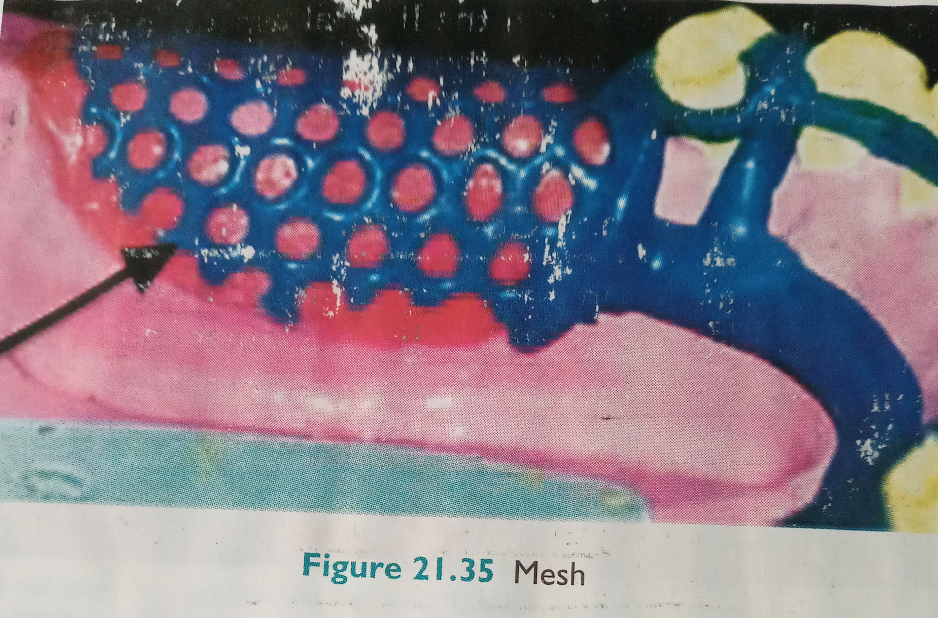

Slide 22
Relief and border extension for a mesh minor connector should be identical to those of open construction
The main drawback of mesh minor connector is the difficulty it presents during the packing of acrylic resin.
Increased pressure is needed to force resin through the small holes in the minor connector
Insufficient packing pressure may result in inadequate resin penetration and a weak attachment to the framework

Slide 23
Mesh construction also may interfere with the arrangement of prosthetic teeth.
Mesh must cover the entire ridge crest and cannot be limited to those areas between the necks of artificial teeth.
As a result, the ridge lap areas of artificial teeth may require significant reduction to facilitate proper arrangement.
Mesh construction, may be used whenever multiple teeth are to replaced

Slide 24
The importance of cast stops
Relief is provided beneath minor connectors of open construction and mesh construction.
This relief provides space between the minor connector and underlying master cast.
This space permits resin to encircle the minor connector and provides a mechanism for attachment of the denture base to the framework.
In distal extension prosthesis the use of relief produces a minor connector that is supported at only one end. As a result , the minor connector may bend when a load is applied. Since considerable force is applied during the packing and processing of acrylic resin, the probability of bending is increased during these procedures.

Slide 25
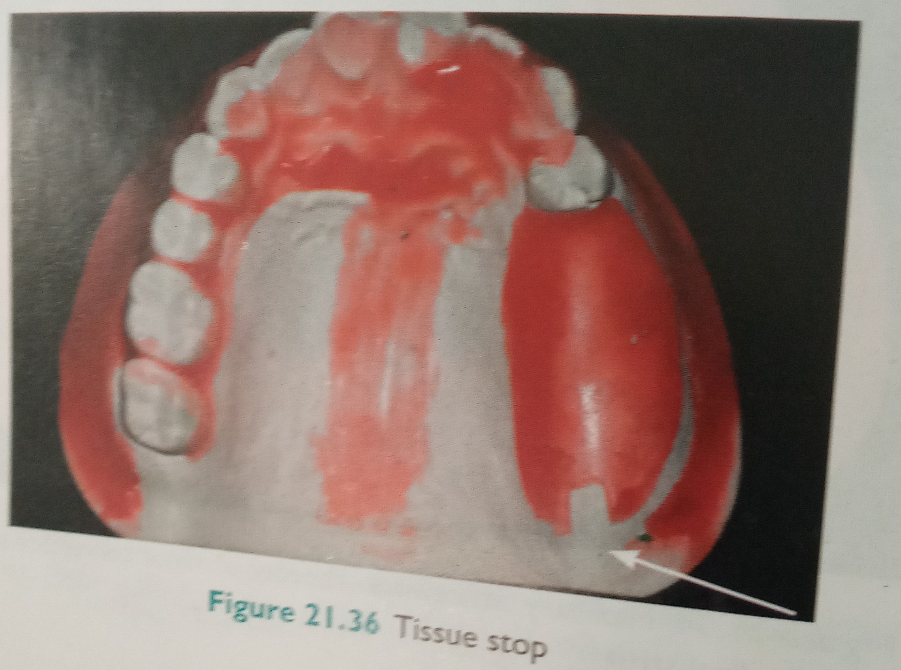

Slide 26
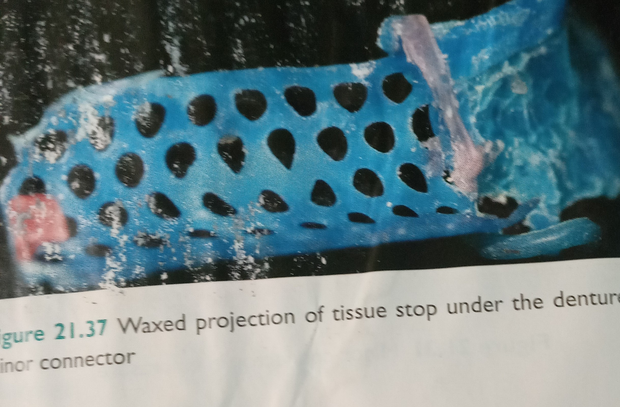

Slide 27
To prevent bending, a small area at the free end of the minor connector should contact the master cast. This portion of the minor connector is termed a cast stop.
A cast stop is created by removing a small square of relief wax (2*2mm) where posterior strut of the minor connector crosses the center of the ridge.
This depression is incorporated into the refractory cast.
During the waxing process , this depression is filled with wax.
Upon casting the framework and returning it to the master cast, the cast stop should contact the surface of the master cast because the minor connector is supported at both ends, bending of the framework can be minimized.

Slide 28
Bead, nail-head or wire construction
Bead , nail head or wire components are often used in conjunction with metal denture bases.
The metal bases are cast to fit directly against the underlying soft tissues.
Hence no relief is provided beneath these minor connectors.
Resin is attached to the free surface of such bases, and retention is gained by encompassment of surface projections.
Projections may be created by placing resin beads on the appropriate segments of wax pattern investing the completed pattern eliminating the pattern materials via heat application, and casting the framework.

Slide 29
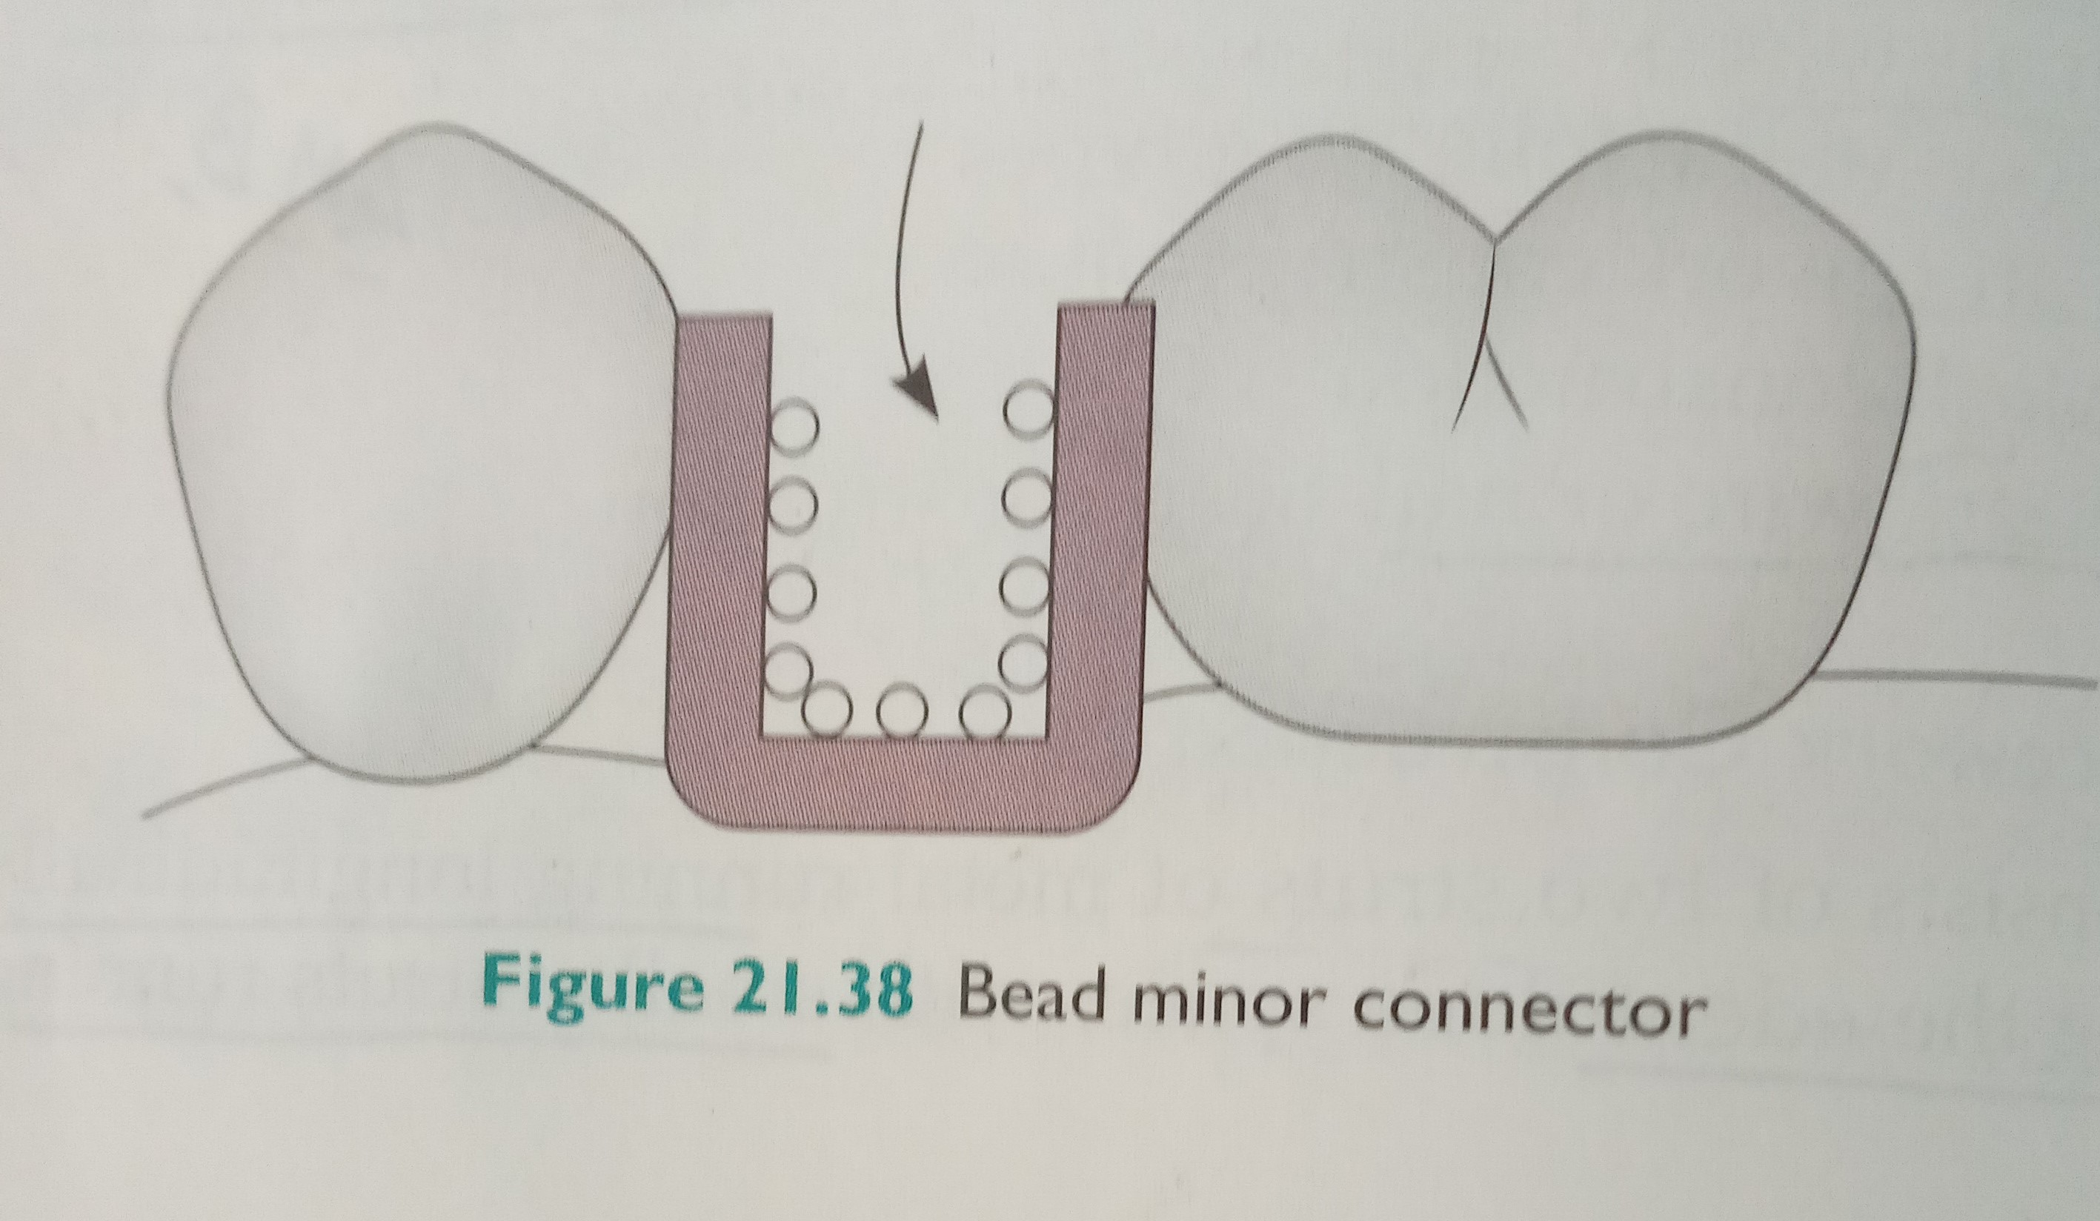

Slide 30
Nail-heads may be produced in a similar manner
Projections also may be added by casting or soldering irregular wire forms to a metal base.
The primary advantage of a metal base is related to improved hygiene and enhanced thermal stimulation
Disadvantages include difficulty in adjusting and relining cast metal bases.
Bead , nail-head, and wire construction should be limited to short-span,tooth-supported applications in patients with well-healed ridges.

Slide 31
Attachment of minor connectors to major connector
A minor connector that supports an acrylic resin denture base must be joined to the major connector with sufficient bulk to avoid fracture.
In addition , each acrylic resin denture base must join the major connector in a smooth,even fashion.
Any irregularity or step between the two surfaces will irritate the tongue or the soft tissues of the ridge.
Consequently, the interfacial geometry and material properties must be considered.

Slide 32
Currently, acrylic resin is used to construct the overwhelming majority of denture bases.
To prevent the acrylic resin from becoming too thin, the designof the resin-metal interface must be considered.
Ideally, a butt joint should be provided so the acrylic resin can blend evenly with the major connector.
Because acrylic resin is processed completely around open minor connectors and mesh minor connectors, resin-metal interfaces must be created on both the internal and external surfaces of the associsted major connector

Slide 33
For metal base minor connectors, acrylic resin is processed only on the external surface.
Therefore,resin metal joints should be created only at the external surfaces.these interfaces are referred to as finish lines.
If they are located on the outer surfaces of major connectors they are called external finish lines.
If they are positioned on the inner or tissue surfaces,they are termed internal finish lines.

Slide 34
Finish lines
Internal finish lines
External finish lines
Formed as a result of relief wax placed on the edentulous ridges of a master cast prior to duplication.
The relief wax 24 to 26gauge creates an elevated area on the resultant refractory cast.
Elevation is necessary to create space for acrylic beneath open and mesh connectors
External finish lines also must be sharp and should be slightly undercut to help lock the acrylic resin to the major connector.
The internal angle formed at the junction of the major minor connectors should be less than 90 degrees.

Slide 35
Internal finish lines
External finish lines
The margins of relief wax establish internal finish lines in the completed metal framework
Margins of the relief wax should be sharp and well defined
An external finish line is formed by the placement and carving of wax during framework.
It should originate at the lingual extent of the rest seat and continue down the lingual aspect of the minor connector

Slide 36
The external finish line should be well defined along its entire length.
The contour of the external finish line should be consistent with the contours of major connector.
Transition from the external finish line to a denture base should be smooth and flowing.

Slide 37
Minor connector serving as approach arms for vertical projection/bar-type clasp
They do not require to be rigid.
Support direct retainers
Approaches the tooth from an apical direction rather than from an occlusal direction
Approach arm should display a smooth, even taper from its terminus.
It must not cross a soft tissue uncut

Slide 38
summary
The connecting link between the major connector or base of a partial removable dental prosthesis and the other units of the prosthesis , such as the clasp assembly , indirect retainers , occlusal rests, or cingulum rests.
It is important to know and understand the minor connector and its types for designing the CPD.

Slide 39
Take home message
The connecting link between the major connector or base of a partial removable dental prosthesis and the other units of the prosthesis , such as the clasp assembly , indirect retainers , occlusal rests, or cingulum rests.
It is important to know and understand the minor connector and its types for designing the CPD.

Slide 40
References
Removable partial prosthodontics 11th edition Mc cracken
Clinical removable partial prosthodontics stewarts
A color atlas of removable partial dentures J.C. Davenport ; R.M. Basker
Advanced Removable Partial Dentures James S. Brudvik
Arthur M. LaVere, and Arthur J. Krol, Selection of a maior connector for the extension-base removable partial denture JPD 1973;30,102-105
Davis Hendersonand Thomas E. Seward Design and force distribution with removable partial dentures: A progress report JPD 1967;17,350-364.

